Slide 1
GEOG0114: Principles of spatial analysis
WEEK 2: Graphical REPRESENTATION OF SPATIAL DATA
Dr Anwar Musah (a.musah@ucl.ac.uk)
Lecturer in Social and Geographic Data Science
UCL Geography
1

Slide 2
Contents
Types of spatial data formats used to describe reality
Vector
Raster
Spatial Operations (or Geoprocessing)
Thematic Mapping
Choropleths
Proportional symbol map
Raster map
Isopleth / Contour maps
4. Issues
Ecological Fallacy bias
Absolute versus Relative
Resolution matters…
Problem
Knowledge
Collect
Model
Wrangle
Explore
2
Notes:
So today we will talk about these items i.e., timetable, assessment…

Slide 3

QUICK recap
Spatial statistics is grounded on spatial dependence and from Tobler’s 1st Law of Geography
We mentioned some fundamental concepts, and two key words for explaining spatial dependence:
Distance decay
Spatial autocorrelation
Spatial spillovers
Event information presented spatially can either be:
Areal/Regional (aka aggregated)
Point patterns
Geostatistical
Let’s rewind a bit to last week
3
Notes:
Before we start, let’s recap on last week

Slide 4
Types of Spatial Data Formats
4

Slide 5
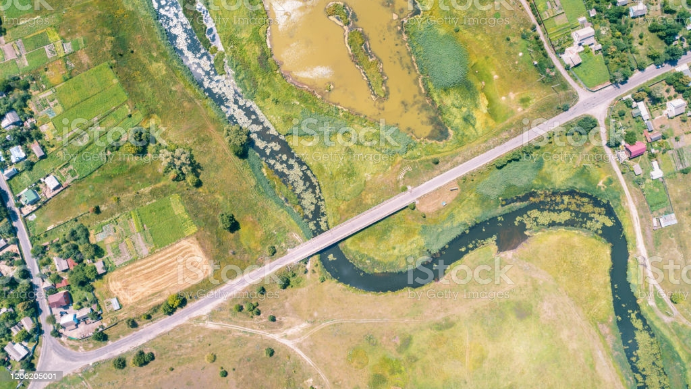
Suppose we want to map the following from this landscape:
1. Physical objects:
Location of buildings
Farm plots
Locations of trees
Road network
Block areas (divided by the road)
2. Levels of soil moisture across the landscape
5
Notes:
Suppose, we want to create a digital map by capturing 2 major things from this landscape:
Physical objects such as….
And we want to display the levels of soil moisture across this entire landscape
Let us expand this image a bit and focus on the physical objects.

Slide 6
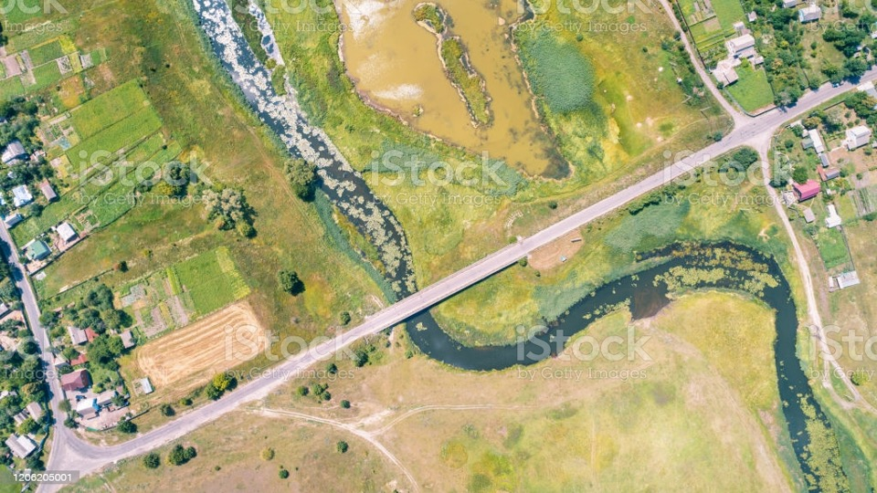
Individual buildings
Road network
Land-use plots (Farm)
Area blocks (partitioned by the roads)
Individual trees
6
Notes:
Suppose we take this image and load it into a GIS software such as QGIS and ArcGIS, where we try to directly extract these
physical objects in the shaded region,
as well as the block areas formed from the road network
And the road network
from the landscape image…

Slide 7
Individual buildings
Road network
Land-use plots (Farms)
Area blocks (partitioned by the roads)
Individual trees
7
Notes:
When we digitise these physical objects i.e., buildings, trees, roads, river stream & land-use
We derive something which we call a ‘spatial feature’
When we remove this landscape image…

Slide 8
Individual buildings
Road network
Land-use plots (Farms)
Area blocks (partitioned by the roads)
Individual trees
8
Notes:
This is what these spatial features will typically by displayed like this in any GIS software.
Now, we can describe these features with some text or numerical information called “attribute”.
We have two keywords: Spatial Feature (or Feature) and Attribute.

Slide 9
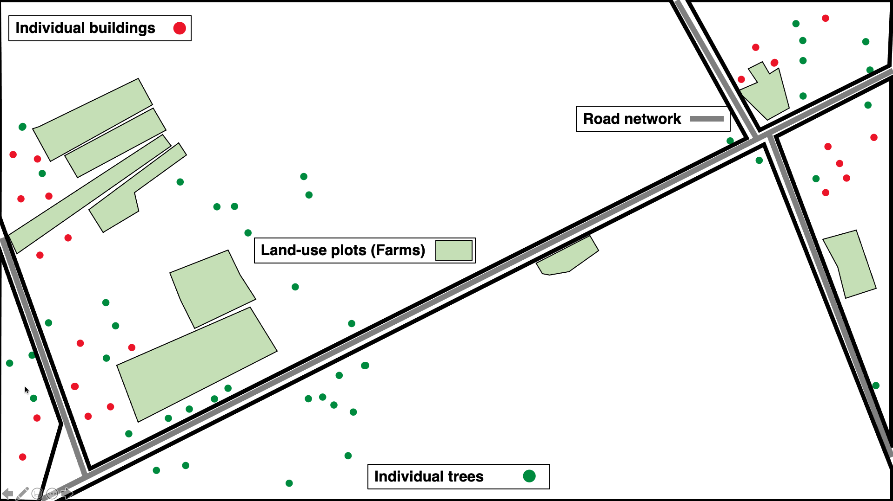
Individual buildings
Individual trees
Road network
Land-use plots (Farms)
Area block
The above objects listed are called “Features”. A feature can be described according to its characteristics which is termed an “Attribute” in GIS. The attribute of a feature can be a numeric or text observation.
For example:
A building is a point feature on this map, the number of people living a building is a numeric attribute describing this feature. Type of building (i.e., Victorian or modern) is a text attribute
The road network is a polyline feature, the length (or distance (m)) of the road is a numeric attribute describing the road
Land-use plot is a polygon (or area) feature, the type of land-use (i.e., farming) is the text attribute describing what that polygon is etc.
9

Slide 10
Individual buildings
Individual trees
Road network
Land-use plots (Farms)
Area block
Now, the above objects are typically Discrete features, and therefore classed a Vector Data
There are three main types of Vector Data:
Point vector
Polylines or Line vector
Polygon vector
10

Slide 11
Individual buildings
Individual trees
Road network
Land-use plots (Farms)
Area block
Now, the above objects are typically Discrete features, and therefore classed a Vector Data
There are three main types of Vector Data:
Point vector
Polylines or Line vector
Polygon vector
Characteristics of a point vector
X, Y location characterize as a coordinate
Has no area
Has no length
This applies to discrete features of sample points
Its geometry consists of a single node or vertex
11

Slide 12
Individual buildings
Individual trees
Road network
Land-use plots (Farms)
Area block
Now, the above objects are typically Discrete features, and therefore classed a Vector Data
There are three main types of Vector Data:
Point vector
Polylines or Line vector
Polygon vector
Characteristics of a polyline or line vector
These are a series of X, Y points characterize by coordinates to form a line
Has no area
They have a length
They have a direction (important for visualizing rivers steams & roads)
Connectivity (it connecting to other lines segments in the network)
This applies to features without an area but with a length – roads, rivers, railway tracks or migration flows between two or more locations.
Its geometry consists of 2 nodes (i.e., beginning and end of point of line) & can have more than one vertex (i.e., point(s) that connect different lines together)
It is never enclosed
12

Slide 13
Individual buildings
Individual trees
Road network
Land-use plots (Farms)
Area block
Now, the above objects are typically Discrete features, and therefore classed a Vector Data
There are three main types of Vector Data:
Point vector
Polylines or Line vector
Polygon vector
Characteristics of a polygon vector
These are a series of X, Y points characterize by coordinates to form an enclosed region
It has an area
It has no length but rather a perimeter instead
This applies to features with enclosed regions – e.g., postcode areas, area of residential premise, counties (other administrative boundaries) etc.
Polygons have three vertices or more each connecting sequentially where the first vertex connects with the last vertex.
13

Slide 14
What about the soil moisture
14

Slide 15
6 | 7 | 8 | 10 | 0 | 0 | 10 | 10 | 0 | 0 | 0 | 0 | 10 | 5 | 3 | 0 | 0 | 0 | 0 | 0
6 | 7 | 8 | 10 | 0 | 0 | 10 | 10 | 0 | 0 | 10 | 0 | 10 | 6 | 3 | 0 | 0 | 0 | 0 | 0
6 | 7 | 8 | 10 | 10 | 0 | 10 | 10 | 0 | 0 | 10 | 0 | 10 | 7 | 5 | 3 | 0 | 0 | 0 | 0
5 | 6 | 8 | 9 | 10 | 10 | 0 | 10 | 0 | 0 | 10 | 0 | 10 | 7 | 5 | 3 | 0 | 0 | 0 | 0
1 | 4 | 8 | 9 | 9 | 10 | 0 | 10 | 10 | 10 | 0 | 0 | 0 | 7 | 5 | 3 | 0 | 0 | 0 | 0
0 | 4 | 8 | 9 | 9 | 10 | 10 | 0 | 10 | 9 | 9 | 0 | 0 | 5 | 3 | 0 | 0 | 0 | 0 | 0
0 | 4 | 8 | 8 | 9 | 9 | 10 | 0 | 0 | 9 | 8 | 7 | 5 | 0 | 0 | 0 | 1 | 0 | 0 | 0
0 | 3 | 5 | 8 | 8 | 9 | 10 | 10 | 0 | 9 | 7 | 5 | 0 | 0 | 5 | 5 | 5 | 0 | 0 | 0
0 | 0 | 3 | 5 | 8 | 9 | 9 | 10 | 0 | 0 | 3 | 0 | 0 | 0 | 5 | 0 | 0 | 1 | 0 | 0
0 | 2 | 2 | 5 | 8 | 8 | 9 | 9 | 10 | 0 | 0 | 0 | 1 | 5 | 0 | 0 | 0 | 0 | 0 | 0
0 | 2 | 2 | 4 | 6 | 8 | 8 | 9 | 0 | 0 | 0 | 1 | 5 | 0 | 0 | 5 | 5 | 5 | 0 | 0
0 | 0 | 0 | 3 | 6 | 8 | 8 | 0 | 0 | 0 | 0 | 5 | 0 | 5 | 5 | 5 | 5 | 5 | 0 | 0
0 | 0 | 2 | 2 | 5 | 8 | 0 | 0 | 0 | 0 | 0 | 0 | 5 | 5 | 5 | 5 | 5 | 5 | 3 | 0
0 | 0 | 0 | 2 | 5 | 0 | 0 | 1 | 2 | 3 | 4 | 4 | 4 | 4 | 4 | 4 | 4 | 5 | 0 | 0
0 | 0 | 0 | 0 | 0 | 0 | 1 | 1 | 1 | 1 | 4 | 4 | 4 | 4 | 4 | 4 | 4 | 5 | 0 | 0
0 | 0 | 0 | 0 | 1 | 1 | 2 | 2 | 2 | 2 | 3 | 3 | 3 | 3 | 3 | 3 | 3 | 4 | 0 | 3
0 | 0 | 1 | 1 | 1 | 1 | 2 | 2 | 3 | 3 | 3 | 3 | 3 | 3 | 3 | 3 | 3 | 4 | 0 | 3
Amount of moisture in soil at any of spot in these rectangle pixels to see change in gradient
Notes:
Continuous information for any spot you see in these grids e.g., amount of rainfall
How do we translate these into spatial data?

Slide 16
6 | 7 | 8 | 10 | 0 | 0 | 10 | 10 | 0 | 0 | 0 | 0 | 10 | 5 | 3 | 0 | 0 | 0 | 0 | 0
6 | 7 | 8 | 10 | 0 | 0 | 10 | 10 | 0 | 0 | 10 | 0 | 10 | 6 | 3 | 0 | 0 | 0 | 0 | 0
6 | 7 | 8 | 10 | 10 | 0 | 10 | 10 | 0 | 0 | 10 | 0 | 10 | 7 | 5 | 3 | 0 | 0 | 0 | 0
5 | 6 | 8 | 9 | 10 | 10 | 0 | 10 | 0 | 0 | 10 | 0 | 10 | 7 | 5 | 3 | 0 | 0 | 0 | 0
1 | 4 | 8 | 9 | 9 | 10 | 0 | 10 | 10 | 10 | 0 | 0 | 0 | 7 | 5 | 3 | 0 | 0 | 0 | 0
0 | 4 | 8 | 9 | 9 | 10 | 10 | 0 | 10 | 9 | 9 | 0 | 0 | 5 | 3 | 0 | 0 | 0 | 0 | 0
0 | 4 | 8 | 8 | 9 | 9 | 10 | 0 | 0 | 9 | 8 | 7 | 5 | 0 | 0 | 0 | 1 | 0 | 0 | 0
0 | 3 | 5 | 8 | 8 | 9 | 10 | 10 | 0 | 9 | 7 | 5 | 0 | 0 | 5 | 5 | 5 | 0 | 0 | 0
0 | 2 | 3 | 5 | 8 | 9 | 9 | 10 | 0 | 0 | 3 | 0 | 0 | 0 | 5 | 0 | 0 | 1 | 0 | 0
0 | 2 | 2 | 5 | 8 | 8 | 9 | 9 | 10 | 0 | 0 | 0 | 1 | 5 | 0 | 0 | 0 | 0 | 0 | 0
0 | 2 | 2 | 4 | 6 | 8 | 8 | 9 | 0 | 0 | 0 | 1 | 5 | 0 | 0 | 5 | 5 | 5 | 0 | 0
0 | 0 | 2 | 3 | 6 | 8 | 8 | 0 | 0 | 0 | 0 | 5 | 0 | 5 | 5 | 5 | 5 | 5 | 0 | 0
0 | 0 | 2 | 2 | 5 | 8 | 0 | 0 | 0 | 0 | 0 | 0 | 5 | 5 | 5 | 5 | 5 | 5 | 3 | 0
0 | 0 | 0 | 2 | 5 | 0 | 0 | 1 | 2 | 3 | 4 | 4 | 4 | 4 | 4 | 4 | 4 | 5 | 0 | 0
0 | 0 | 0 | 0 | 0 | 0 | 1 | 1 | 1 | 1 | 4 | 4 | 4 | 4 | 4 | 4 | 4 | 5 | 0 | 0
0 | 0 | 0 | 0 | 1 | 1 | 2 | 2 | 2 | 2 | 3 | 3 | 3 | 3 | 3 | 3 | 3 | 4 | 0 | 3
0 | 0 | 1 | 1 | 1 | 1 | 2 | 2 | 3 | 3 | 3 | 3 | 3 | 3 | 3 | 3 | 3 | 4 | 0 | 3
Soil moisture index
 | 10
 | 7 to 9
 | 4 to 6
 | 1 to 3
 | 0
Unlike the vector data. The above feature describes how moisture levels across the surface of the landscape – the feature is is not measured discretely but on a continuous surface to show gradient in changes for soil moisture across the landscape
Now, this Non-discrete feature is classed a Raster Data
What is Raster Data?
It is a matrix of pixels or grid-cells that contains a numeric or text value for a feature its representing
It is composed of rows and columns
Each pixel or grid-cell has a resolution (or size for height and width)
16
Notes:
Here is a bird’s eye view of a location.
Let’s say that we want to make a map of this piece of landscape – and we wanted to map the following things –

Slide 17
6 | 7 | 8 | 10 | 0 | 0 | 10 | 10 | 0 | 0 | 0 | 0 | 10 | 5 | 3 | 0 | 0 | 0 | 0 | 0
6 | 7 | 8 | 10 | 0 | 0 | 10 | 10 | 0 | 0 | 10 | 0 | 10 | 6 | 3 | 0 | 0 | 0 | 0 | 0
6 | 7 | 8 | 10 | 10 | 0 | 10 | 10 | 0 | 0 | 10 | 0 | 10 | 7 | 5 | 3 | 0 | 0 | 0 | 0
5 | 6 | 8 | 9 | 10 | 10 | 0 | 10 | 0 | 0 | 10 | 0 | 10 | 7 | 5 | 3 | 0 | 0 | 0 | 0
1 | 4 | 8 | 9 | 9 | 10 | 0 | 10 | 10 | 10 | 0 | 0 | 0 | 7 | 5 | 3 | 0 | 0 | 0 | 0
0 | 4 | 8 | 9 | 9 | 10 | 10 | 0 | 10 | 9 | 9 | 0 | 0 | 5 | 3 | 0 | 0 | 0 | 0 | 0
0 | 4 | 8 | 8 | 9 | 9 | 10 | 0 | 0 | 9 | 8 | 7 | 5 | 0 | 0 | 0 | 1 | 0 | 0 | 0
0 | 3 | 5 | 8 | 8 | 9 | 10 | 10 | 0 | 9 | 7 | 5 | 0 | 0 | 5 | 5 | 5 | 0 | 0 | 0
0 | 2 | 3 | 5 | 8 | 9 | 9 | 10 | 0 | 0 | 3 | 0 | 0 | 0 | 5 | 0 | 0 | 1 | 0 | 0
0 | 2 | 2 | 5 | 8 | 8 | 9 | 9 | 10 | 0 | 0 | 0 | 1 | 5 | 0 | 0 | 0 | 0 | 0 | 0
0 | 2 | 2 | 4 | 6 | 8 | 8 | 9 | 0 | 0 | 0 | 1 | 5 | 0 | 0 | 5 | 5 | 5 | 0 | 0
0 | 0 | 2 | 3 | 6 | 8 | 8 | 0 | 0 | 0 | 0 | 5 | 0 | 5 | 5 | 5 | 5 | 5 | 0 | 0
0 | 0 | 2 | 2 | 5 | 8 | 0 | 0 | 0 | 0 | 0 | 0 | 5 | 5 | 5 | 5 | 5 | 5 | 3 | 0
0 | 0 | 0 | 2 | 5 | 0 | 0 | 1 | 2 | 3 | 4 | 4 | 4 | 4 | 4 | 4 | 4 | 5 | 0 | 0
0 | 0 | 0 | 0 | 0 | 0 | 1 | 1 | 1 | 1 | 4 | 4 | 4 | 4 | 4 | 4 | 4 | 5 | 0 | 0
0 | 0 | 0 | 0 | 1 | 1 | 2 | 2 | 2 | 2 | 3 | 3 | 3 | 3 | 3 | 3 | 3 | 4 | 0 | 3
0 | 0 | 1 | 1 | 1 | 1 | 2 | 2 | 3 | 3 | 3 | 3 | 3 | 3 | 3 | 3 | 3 | 4 | 0 | 3
Soil moisture index
 | 10
 | 7 to 9
 | 4 to 6
 | 1 to 3
 | 0
Characteristics of Raster Data and its pixels (or grid cells):
It can take any shape (circle, square, rectangle, hexagon etc.). The usual shape you will encounter is a square
Resolution (width and height: units - m, km, miles etc.)
Height
Width
17

Slide 18
6 | 7 | 8 | 10 | 0 | 0 | 10 | 10 | 0 | 0 | 0 | 0 | 10 | 5 | 3 | 0 | 0 | 0 | 0 | 0
6 | 7 | 8 | 10 | 0 | 0 | 10 | 10 | 0 | 0 | 10 | 0 | 10 | 6 | 3 | 0 | 0 | 0 | 0 | 0
6 | 7 | 8 | 10 | 10 | 0 | 10 | 10 | 0 | 0 | 10 | 0 | 10 | 7 | 5 | 3 | 0 | 0 | 0 | 0
5 | 6 | 8 | 9 | 10 | 10 | 0 | 10 | 0 | 0 | 10 | 0 | 10 | 7 | 5 | 3 | 0 | 0 | 0 | 0
1 | 4 | 8 | 9 | 9 | 10 | 0 | 10 | 10 | 10 | 0 | 0 | 0 | 7 | 5 | 3 | 0 | 0 | 0 | 0
0 | 4 | 8 | 9 | 9 | 10 | 10 | 0 | 10 | 9 | 9 | 0 | 0 | 5 | 3 | 0 | 0 | 0 | 0 | 0
0 | 4 | 8 | 8 | 9 | 9 | 10 | 0 | 0 | 9 | 8 | 7 | 5 | 0 | 0 | 0 | 1 | 0 | 0 | 0
0 | 3 | 5 | 8 | 8 | 9 | 10 | 10 | 0 | 9 | 7 | 5 | 0 | 0 | 5 | 5 | 5 | 0 | 0 | 0
0 | 2 | 3 | 5 | 8 | 9 | 9 | 10 | 0 | 0 | 3 | 0 | 0 | 0 | 5 | 0 | 0 | 1 | 0 | 0
0 | 2 | 2 | 5 | 8 | 8 | 9 | 9 | 10 | 0 | 0 | 0 | 1 | 5 | 0 | 0 | 0 | 0 | 0 | 0
0 | 2 | 2 | 4 | 6 | 8 | 8 | 9 | 0 | 0 | 0 | 1 | 5 | 0 | 0 | 5 | 5 | 5 | 0 | 0
0 | 0 | 2 | 3 | 6 | 8 | 8 | 0 | 0 | 0 | 0 | 5 | 0 | 5 | 5 | 5 | 5 | 5 | 0 | 0
0 | 0 | 2 | 2 | 5 | 8 | 0 | 0 | 0 | 0 | 0 | 0 | 5 | 5 | 5 | 5 | 5 | 5 | 3 | 0
0 | 0 | 0 | 2 | 5 | 0 | 0 | 1 | 2 | 3 | 4 | 4 | 4 | 4 | 4 | 4 | 4 | 5 | 0 | 0
0 | 0 | 0 | 0 | 0 | 0 | 1 | 1 | 1 | 1 | 4 | 4 | 4 | 4 | 4 | 4 | 4 | 5 | 0 | 0
0 | 0 | 0 | 0 | 1 | 1 | 2 | 2 | 2 | 2 | 3 | 3 | 3 | 3 | 3 | 3 | 3 | 4 | 0 | 3
0 | 0 | 1 | 1 | 1 | 1 | 2 | 2 | 3 | 3 | 3 | 3 | 3 | 3 | 3 | 3 | 3 | 4 | 0 | 3
Soil moisture index
 | 10
 | 7 to 9
 | 4 to 6
 | 1 to 3
 | 0
Example with Boolean
Characteristics of Raster Data and its pixels (or grid cells):
It can take any shape (circle, square, rectangle, hexagon etc.). The usual shape you will encounter is a square
Resolution (width and height: units - m, km, miles etc.)
Data types:
Integer: for discrete values (e.g., above raster for moisture)
Boolean (or Binary) 1 = “Yes” and 0 = “No” (Presence/absence)
1
Height
Width
18

Slide 19
6 | 7 | 8 | 10 | 0 | 0 | 10 | 10 | 0 | 0 | 0 | 0 | 10 | 5 | 3 | 0 | 0 | 0 | 0 | 0
6 | 7 | 8 | 10 | 0 | 0 | 10 | 10 | 0 | 0 | 10 | 0 | 10 | 6 | 3 | 0 | 0 | 0 | 0 | 0
6 | 7 | 8 | 10 | 10 | 0 | 10 | 10 | 0 | 0 | 10 | 0 | 10 | 7 | 5 | 3 | 0 | 0 | 0 | 0
5 | 6 | 8 | 9 | 10 | 10 | 0 | 10 | 0 | 0 | 10 | 0 | 10 | 7 | 5 | 3 | 0 | 0 | 0 | 0
1 | 4 | 8 | 9 | 9 | 10 | 0 | 10 | 10 | 10 | 0 | 0 | 0 | 7 | 5 | 3 | 0 | 0 | 0 | 0
0 | 4 | 8 | 9 | 9 | 10 | 10 | 0 | 10 | 9 | 9 | 0 | 0 | 5 | 3 | 0 | 0 | 0 | 0 | 0
0 | 4 | 8 | 8 | 9 | 9 | 10 | 0 | 0 | 9 | 8 | 7 | 5 | 0 | 0 | 0 | 1 | 0 | 0 | 0
0 | 3 | 5 | 8 | 8 | 9 | 10 | 10 | 0 | 9 | 7 | 5 | 0 | 0 | 5 | 5 | 5 | 0 | 0 | 0
0 | 2 | 3 | 5 | 8 | 9 | 9 | 10 | 0 | 0 | 3 | 0 | 0 | 0 | 5 | 0 | 0 | 1 | 0 | 0
0 | 2 | 2 | 5 | 8 | 8 | 9 | 9 | 10 | 0 | 0 | 0 | 1 | 5 | 0 | 0 | 0 | 0 | 0 | 0
0 | 2 | 2 | 4 | 6 | 8 | 8 | 9 | 0 | 0 | 0 | 1 | 5 | 0 | 0 | 5 | 5 | 5 | 0 | 0
0 | 0 | 2 | 3 | 6 | 8 | 8 | 0 | 0 | 0 | 0 | 5 | 0 | 5 | 5 | 5 | 5 | 5 | 0 | 0
0 | 0 | 2 | 2 | 5 | 8 | 0 | 0 | 0 | 0 | 0 | 0 | 5 | 5 | 5 | 5 | 5 | 5 | 3 | 0
0 | 0 | 0 | 2 | 5 | 0 | 0 | 1 | 2 | 3 | 4 | 4 | 4 | 4 | 4 | 4 | 4 | 5 | 0 | 0
0 | 0 | 0 | 0 | 0 | 0 | 1 | 1 | 1 | 1 | 4 | 4 | 4 | 4 | 4 | 4 | 4 | 5 | 0 | 0
0 | 0 | 0 | 0 | 1 | 1 | 2 | 2 | 2 | 2 | 3 | 3 | 3 | 3 | 3 | 3 | 3 | 4 | 0 | 3
0 | 0 | 1 | 1 | 1 | 1 | 2 | 2 | 3 | 3 | 3 | 3 | 3 | 3 | 3 | 3 | 3 | 4 | 0 | 3
Soil moisture index
 | 10
 | 7 to 9
 | 4 to 6
 | 1 to 3
 | 0
Example with Float
Characteristics of Raster Data and its pixels (or grid cells):
It can take any shape (circle, square, rectangle, hexagon etc.). The usual shape you will encounter is a square
Resolution (width and height: units - m, km, miles etc.)
Data types:
Integer: for discrete values (e.g., above raster for moisture)
Boolean (or Binary) 1 = “Yes” and 0 = “No” (Presence/absence)
Float (or continuous data)
7.8
Height
Width
19

Slide 20
6 | 7 | 8 | 10 | 0 | 0 | 10 | 10 | 0 | 0 | 0 | 0 | 10 | 5 | 3 | 0 | 0 | 0 | 0 | 0
6 | 7 | 8 | 10 | 0 | 0 | 10 | 10 | 0 | 0 | 10 | 0 | 10 | 6 | 3 | 0 | 0 | 0 | 0 | 0
6 | 7 | 8 | 10 | 10 | 0 | 10 | 10 | 0 | 0 | 10 | 0 | 10 | 7 | 5 | 3 | 0 | 0 | 0 | 0
5 | 6 | 8 | 9 | 10 | 10 | 0 | 10 | 0 | 0 | 10 | 0 | 10 | 7 | 5 | 3 | 0 | 0 | 0 | 0
1 | 4 | 8 | 9 | 9 | 10 | 0 | 10 | 10 | 10 | 0 | 0 | 0 | 7 | 5 | 3 | 0 | 0 | 0 | 0
0 | 4 | 8 | 9 | 9 | 10 | 10 | 0 | 10 | 9 | 9 | 0 | 0 | 5 | 3 | 0 | 0 | 0 | 0 | 0
0 | 4 | 8 | 8 | 9 | 9 | 10 | 0 | 0 | 9 | 8 | 7 | 5 | 0 | 0 | 0 | 1 | 0 | 0 | 0
0 | 3 | 5 | 8 | 8 | 9 | 10 | 10 | 0 | 9 | 7 | 5 | 0 | 0 | 5 | 5 | 5 | 0 | 0 | 0
0 | 2 | 3 | 5 | 8 | 9 | 9 | 10 | 0 | 0 | 3 | 0 | 0 | 0 | 5 | 0 | 0 | 1 | 0 | 0
0 | 2 | 2 | 5 | 8 | 8 | 9 | 9 | 10 | 0 | 0 | 0 | 1 | 5 | 0 | 0 | 0 | 0 | 0 | 0
0 | 2 | 2 | 4 | 6 | 8 | 8 | 9 | 0 | 0 | 0 | 1 | 5 | 0 | 0 | 5 | 5 | 5 | 0 | 0
0 | 0 | 2 | 3 | 6 | 8 | 8 | 0 | 0 | 0 | 0 | 5 | 0 | 5 | 5 | 5 | 5 | 5 | 0 | 0
0 | 0 | 2 | 2 | 5 | 8 | 0 | 0 | 0 | 0 | 0 | 0 | 5 | 5 | 5 | 5 | 5 | 5 | 3 | 0
0 | 0 | 0 | 2 | 5 | 0 | 0 | 1 | 2 | 3 | 4 | 4 | 4 | 4 | 4 | 4 | 4 | 5 | 0 | 0
0 | 0 | 0 | 0 | 0 | 0 | 1 | 1 | 1 | 1 | 4 | 4 | 4 | 4 | 4 | 4 | 4 | 5 | 0 | 0
0 | 0 | 0 | 0 | 1 | 1 | 2 | 2 | 2 | 2 | 3 | 3 | 3 | 3 | 3 | 3 | 3 | 4 | 0 | 3
0 | 0 | 1 | 1 | 1 | 1 | 2 | 2 | 3 | 3 | 3 | 3 | 3 | 3 | 3 | 3 | 3 | 4 | 0 | 3
Soil moisture index
 | 10
 | 7 to 9
 | 4 to 6
 | 1 to 3
 | 0
Example with Missing
Characteristics of Raster Data and its pixels (or grid cells):
It can take any shape (circle, square, rectangle, hexagon etc.). The usual shape you will encounter is a square
Resolution (width and height: units - m, km, miles etc.)
Data types:
Integer: for discrete values (e.g., above raster for moisture)
Boolean (or Binary) 1 = “Yes” and 0 = “No” (Presence/absence)
Float (or continuous data)
No data, missing value in pixel: NA, NaN
NaN
Height
Width
20

Slide 21
6 | 7 | 8 | 10 | 0 | 0 | 10 | 10 | 0 | 0 | 0 | 0 | 10 | 5 | 3 | 0 | 0 | 0 | 0 | 0
6 | 7 | 8 | 10 | 0 | 0 | 10 | 10 | 0 | 0 | 10 | 0 | 10 | 6 | 3 | 0 | 0 | 0 | 0 | 0
6 | 7 | 8 | 10 | 10 | 0 | 10 | 10 | 0 | 0 | 10 | 0 | 10 | 7 | 5 | 3 | 0 | 0 | 0 | 0
5 | 6 | 8 | 9 | 10 | 10 | 0 | 10 | 0 | 0 | 10 | 0 | 10 | 7 | 5 | 3 | 0 | 0 | 0 | 0
1 | 4 | 8 | 9 | 9 | 10 | 0 | 10 | 10 | 10 | 0 | 0 | 0 | 7 | 5 | 3 | 0 | 0 | 0 | 0
0 | 4 | 8 | 9 | 9 | 10 | 10 | 0 | 10 | 9 | 9 | 0 | 0 | 5 | 3 | 0 | 0 | 0 | 0 | 0
0 | 4 | 8 | 8 | 9 | 9 | 10 | 0 | 0 | 9 | 8 | 7 | 5 | 0 | 0 | 0 | 1 | 0 | 0 | 0
0 | 3 | 5 | 8 | 8 | 9 | 10 | 10 | 0 | 9 | 7 | 5 | 0 | 0 | 5 | 5 | 5 | 0 | 0 | 0
0 | 2 | 3 | 5 | 8 | 9 | 9 | 10 | 0 | 0 | 3 | 0 | 0 | 0 | 5 | 0 | 0 | 1 | 0 | 0
0 | 2 | 2 | 5 | 8 | 8 | 9 | 9 | 10 | 0 | 0 | 0 | 1 | 5 | 0 | 0 | 0 | 0 | 0 | 0
0 | 2 | 2 | 4 | 6 | 8 | 8 | 9 | 0 | 0 | 0 | 1 | 5 | 0 | 0 | 5 | 5 | 5 | 0 | 0
0 | 0 | 2 | 3 | 6 | 8 | 8 | 0 | 0 | 0 | 0 | 5 | 0 | 5 | 5 | 5 | 5 | 5 | 0 | 0
0 | 0 | 2 | 2 | 5 | 8 | 0 | 0 | 0 | 0 | 0 | 0 | 5 | 5 | 5 | 5 | 5 | 5 | 3 | 0
0 | 0 | 0 | 2 | 5 | 0 | 0 | 1 | 2 | 3 | 4 | 4 | 4 | 4 | 4 | 4 | 4 | 5 | 0 | 0
0 | 0 | 0 | 0 | 0 | 0 | 1 | 1 | 1 | 1 | 4 | 4 | 4 | 4 | 4 | 4 | 4 | 5 | 0 | 0
0 | 0 | 0 | 0 | 1 | 1 | 2 | 2 | 2 | 2 | 3 | 3 | 3 | 3 | 3 | 3 | 3 | 4 | 0 | 3
0 | 0 | 1 | 1 | 1 | 1 | 2 | 2 | 3 | 3 | 3 | 3 | 3 | 3 | 3 | 3 | 3 | 4 | 0 | 3
Vector data
Raster data
21

Slide 22
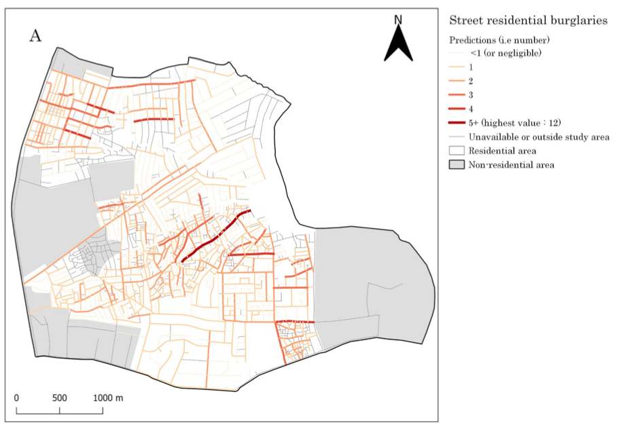
Let’s look at this first example:
The map on the left shows the predicted numbers of burglaries across streets for a small city in Kaduna, Nigeria (Musah et al. 2020)
What types of spatial data are shown in the map on the left?
What kinds of features are included in this visualisation?
For the street segments, what is the main attribute for their visualisation?
Image: Show predicted cases of residential burglaries in study area
Sources:
Musah, A., et al. (2020): https://doi.org/10.1016/j.apgeog.2019.102126
22

Slide 23
What types spatial data are shown in the map on the left?
Vector data only
What kinds of features are included in this visualisation?
Polyline (Street segments)
Polygon (Residential area (white))
Polygon (Non-residential area (grey))
Polygon (Black outline of study area)
For the street segments, what is the main attribute for their visualisation?
Feature: Polyline (Streets)
Attribute: Predicted burglaries
The map is an example of vector map with line segments, which is one of many types of thematic maps
Image: Show predicted cases of residential burglaries in study area
Sources:
Musah, A., et al. (2020): https://doi.org/10.1016/j.apgeog.2019.102126
23

Slide 24
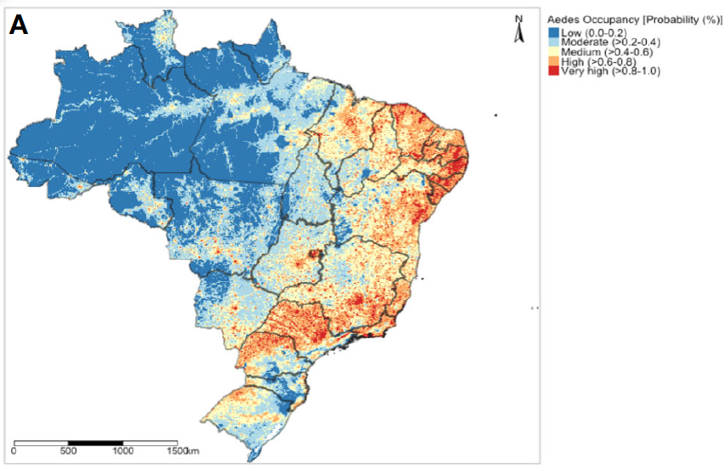
Let’s look at this second example:
The map on the left shows the predicted risk of mosquito (Aedes aegypti) occupancy in Brazil (Musah et al. 2023)
What types of spatial data are shown in the map on the left?
What kinds of features are included in this visualisation?
For the raster, what is the main attribute for their visualisation?
Image: Show predicted probability mosquito occupancy to indicate where Aedes aegypti thrive in Brazil
Sources:
Musah, A., et al. (2023): https://doi.org/10.3389/fitd.2023.1039735
24

Slide 25
What types spatial data are shown in the map on the left?
Mainly raster data, and vector data
What kinds of features are included in this visualisation?
Polygon (Brazilian States)
Raster (Prediction of risk)
For the street segments (polylines), what is the main attribute for their visualisation?
Feature: Raster (4.5km by 4.5km)
Attribute: Predicted probability
The map is an example of raster map with predictions store in pixels/grid points, which is one of many types of thematic maps
Image: Show predicted probability mosquito occupancy to indicate where Aedes aegypti thrive in Brazil
Sources:
Musah, A., et al. (2023): https://doi.org/10.3389/fitd.2023.1039735
25

Slide 26
Spatial Operations, or Geoprocessing
26

Slide 27
Definition: Geoprocessing is a collection of tools that offers a framework for dealing with geographic data
Its purpose is to help users in the data management and automation of GIS tasks for spatial data.
For performing geospatial modelling and analysis of vector and raster data.
In terms of spatial operations, the most problem you will encounter are:
Clipping
Intersection
Union
Dissolving
Aggregation
Buffer
27

Slide 28
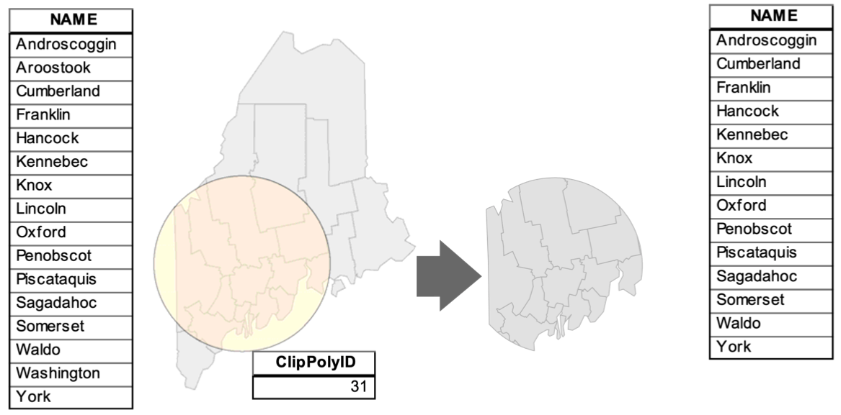
Clipping
Capture spatial data within a region of interest
State of Maine
Suppose we want to capture only the counties within that circular shape.
We are going to use the circular shapefile as our “cookie cutter” to capture the counties within it and clip out the areas that fall outside it.
The operations is called “Clipping”
Circular polygon is our ‘cookie cutter’ for the clipping
Source: Gimond, M. 2021. Intro to GIS and Spatial Analysis. [online]. https://mgimond.github.io/Spatial/introGIS.html
28
Notes:
16 counties in the State of Maine
To demonstrate, we have a circular polygon which we use to capture any spatial data i.e., counties in the State of Maine that fall within that polygon.
Slices of 14 counties (regardless of whether a sliver exists within that crop region).

Slide 29
Clipping
Capture spatial data within a region of interest
Before
State of Maine
Clipped area
X = Aroostook and Somerset are excluded
X
X
Source: Gimond, M. 2021. Intro to GIS and Spatial Analysis. [online]. https://mgimond.github.io/Spatial/introGIS.html
This spatial operation can be applied to all types of spatial data:
Clipping points to fall within an area (i.e., vector to vector)
Clipping smaller areal units to fall within a larger area (i.e., vector to vector)
Clipping raster cells to fall within a spatial area (i.e., vector to raster)
29
Notes:
16 counties in the State of Maine
To demonstrate, we have a circular polygon which we use to capture any spatial data i.e., counties in the State of Maine that fall within that polygon.
Slices of 14 counties (regardless of whether a sliver exists within that crop region).

Slide 30
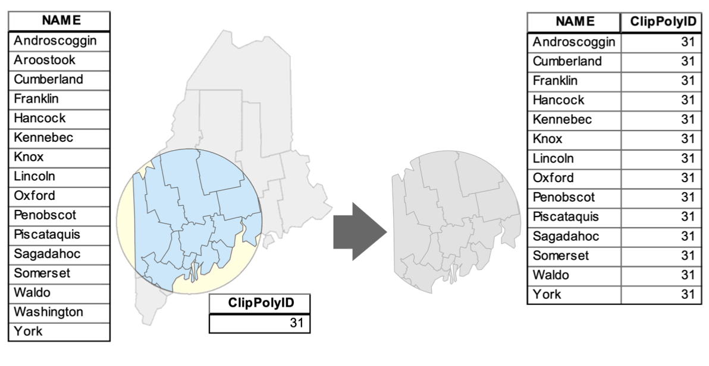
Intersection
Capture spatial data between two or more overlapping spatial data
Source: Gimond, M. 2021. Intro to GIS and Spatial Analysis. [online]. https://mgimond.github.io/Spatial/introGIS.html
This type of spatial operation can be applied to the following:
Intersecting points to areas (i.e., vector to vector)
Intersecting smaller areal units that fall within a larger area (i.e., vector to vector)
Intersecting points with raster (i.e., vector to raster)
30

Slide 31
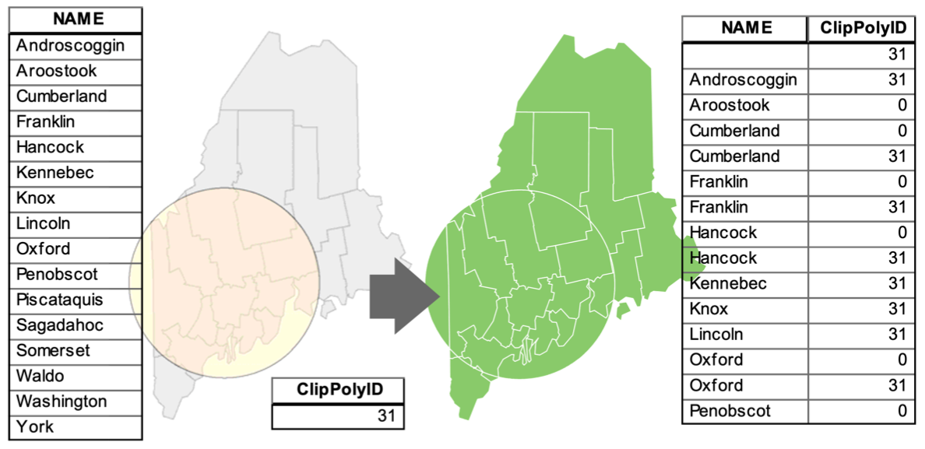
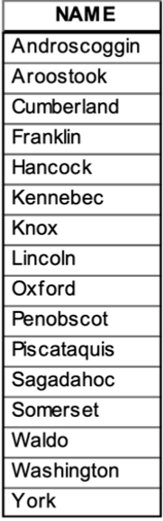
Union
Bringing together two or more different vectors objects to one
N/A
N/A
N/A
N/A
N/A
N/A
N/A
N/A
N/A
N/A
N/A
N/A
N/A
N/A
N/A
N/A
Source: Gimdond, M. 2021. Intro to GIS and Spatial Analysis. [online]. https://mgimond.github.io/Spatial/introGIS.html
This type of spatial operation can be applied to the following:
You union all types of vector data (i.e., points, lines and polygons)
It’s a vector-to-vector spatial operation only. You cannot union a vector with a raster. The raster must be vectorised before it can be in union with another vector
31

Slide 32
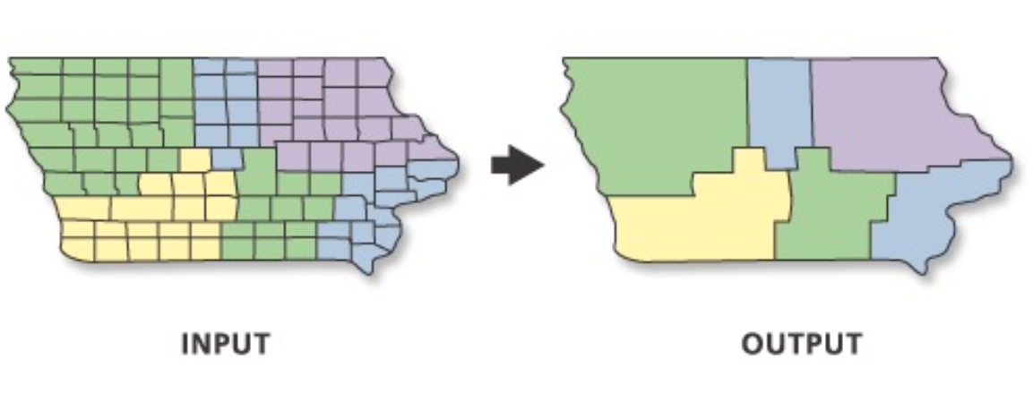
Dissolving
Amalgamate or merge smaller adjacent vector units to form another vector unit.
Source: ESRI (2021) Dissolve https://pro.arcgis.com/en/pro-app/latest/tool-reference/data-management/dissolve.htm
This type of spatial operation can be applied to the following:
You dissolve only the following types of vector data (i.e., lines and polygons)
It cannot be applied to vector points
32

Slide 33
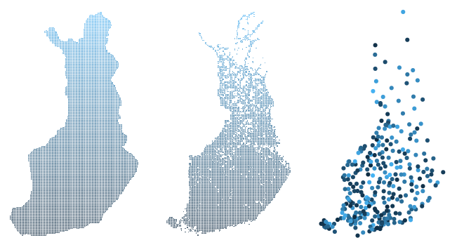
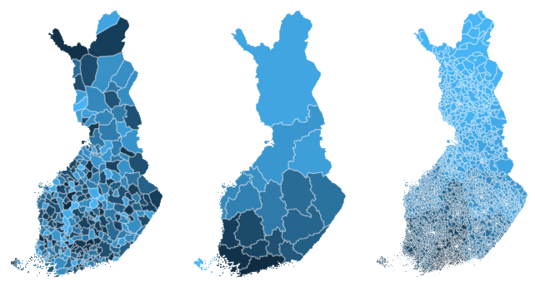
Aggregation
Aggregating values (i.e., summing, or averaging) of smaller spatial units that fall within a larger spatial unit.
Population density grid (raster)
Postcode areas (vector)
Municipalities (vector)
Regions (vector)
Highest resolution
High resolution
Low resolution
Coarser resolution
By aggregating (and summing) the gridded values within any of these vector shapefile, it will produce another shapefile containing the estimated total population within such boundaries
33
Source: geofi (access Finnish [Maakunta region] Geospatial data) https://cran.r-project.org/web/packages/geofi/readme/README.html

Slide 34
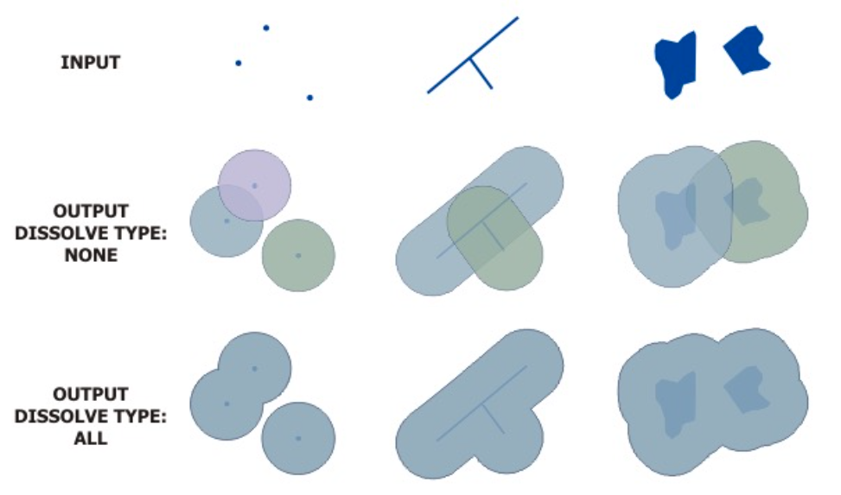
Buffering
Is an area, created by a specified distance, used to surround one or more features
Source: ESRI (2021). Buffer. https://pro.arcgis.com/en/pro-app/latest/tool-reference/analysis/buffer.htm
This type of spatial operation can be applied to the following:
You can create buffers using any type of vector data (i.e., points, lines and polygons)
Buffers is a spatial operation reserved for vector only. This cannot be applied to raster data unless it’s vectorised to a form that incredibly manageable for applying a buffer.
34

Slide 35
Definition: Geoprocessing is a collection of tools that offers a framework for dealing with geographic data
Its purpose is to help users in the data management and automation of GIS tasks for spatial data.
For performing geospatial modelling and analysis of vector and raster data.
In terms of spatial operations, the most problem you will encounter are:
Clipping
Intersection
Union
Dissolving
Aggregation
Buffer
Other types of spatial operations not covered here (but will see frequently in the practicals!)
Spatial transforms of coordinates (reprojecting etc.)
Coordinate systems and projections
Distances
35

Slide 36
The Beginning: Introduction to Spatial Analysis and Data Science
Thematic Mapping & Issues
36

Slide 37
Definition:
Thematic maps are graphical outputs that typically show geographic patterns of a particular theme in a geographic area
There are several types of thematic maps – the most common maps you will encounter are:
Choropleths (e.g., Dot, Lines and Dasymetric maps)
Proportional point symbol maps
Raster maps
37

Slide 38
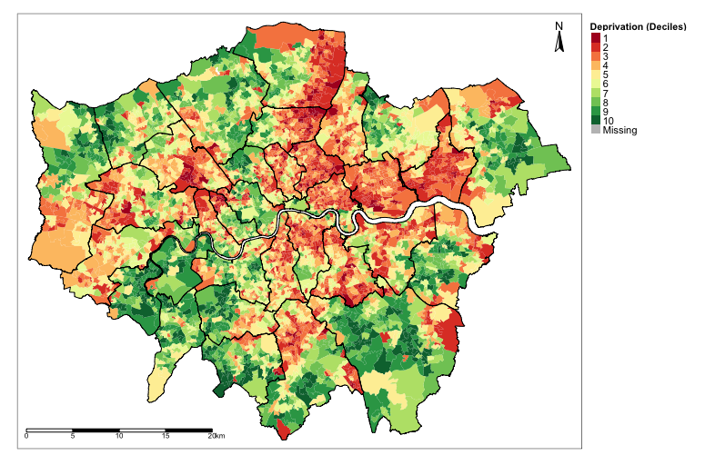
Choropleth Map:
This type of map uses various colour schemes to represent aggregated values (i.e., sum, mean, and some other statistic) of an attribute within a predefined feature (i.e., points, lines or polygons)
The key characteristics about Choropleths are the shading to show data on a map:
Intensity of colours – darker the colour (e.g., deep reds) may represent a higher value and the lighter colour (e.g., brighter reds) is vice versa
Divergent colours – it is best to represent two extremes e.g., deprivation map of London.
Random colours – it is best to use them for categorical variable whose categories have no order (e.g., urban rural classification, land use type etc.)
Choropleths are great to use as they are easy to read and visually Impressive… but they come with their own issues thought!
Image: We have generated a choropleth before in Week 1’s practical. A map showing distribution of deprivation in London
38

Slide 39
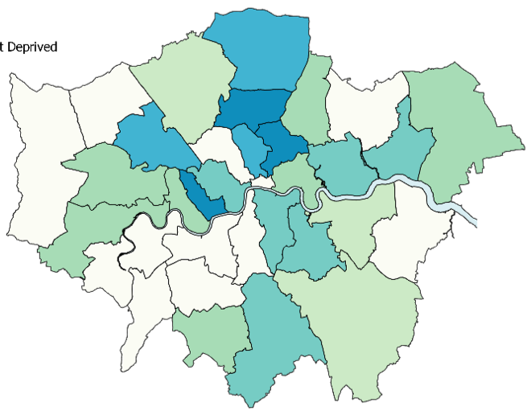
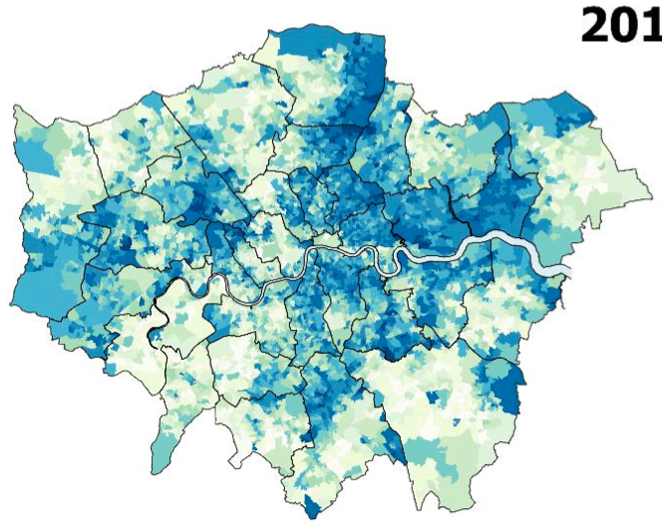
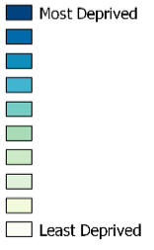











The two maps show the same thing – the one on the left shows levels of Deprivation based on the boroughs of London. While the one on the right shows it at a much higher resolution at a Lower Super Output Area level.
Problems:
The left map assumes the whole area has the same value – so it does not allow for variation within an area. We can see that this is not true because the right shows significant variation within an area.
The left map shows changes from one borough to another are very abrupt – which should not be the case. The variation from least to most deprived should be gradual (i.e., can be clearly seen on right map)
Ecological Fallacy bias is so pronounced in the left map.
The map on the right is a far better Choropleth – this is an example of Dasymetric Map (more revealing)
39
Notes:
When it comes to exploring variability in a particular feature or variable – choropleths can be misleading especially if the data is of low-resolution rendered to something that is higher, and example is take these two images…

Slide 40
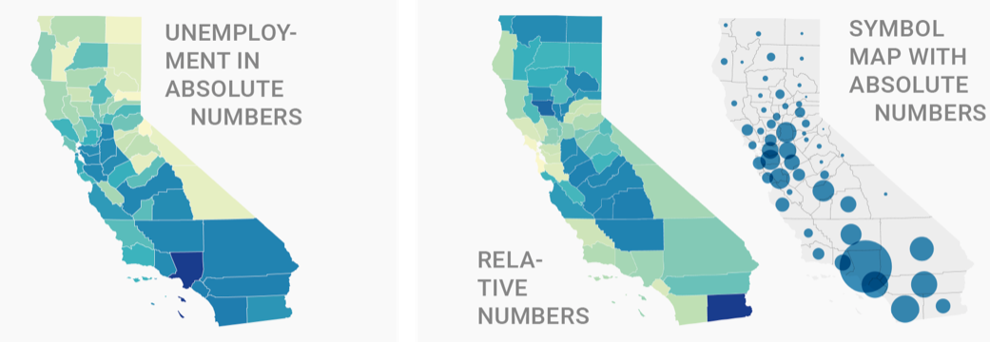
More Problems with Choropleth:
The far-left map uses raw (or absolute) numbers (i.e., number of people unemployed in counties in California). This is not an ideal way for visualizing such data because there is no way for us to compare difference across counties without knowing their population sizes. They are best visualized with relative numbers (i.e., unemployment rate or proportion) (middle map).
If you got to map data with absolute numbers – because the denominators are unavailable – then use symbols whose sizes are proportional to the absolute value (i.e., far-right map)
The map on the far-right is a far better Choropleth for absolute values – that example is called Proportional Point Symbol Map
40

Slide 41
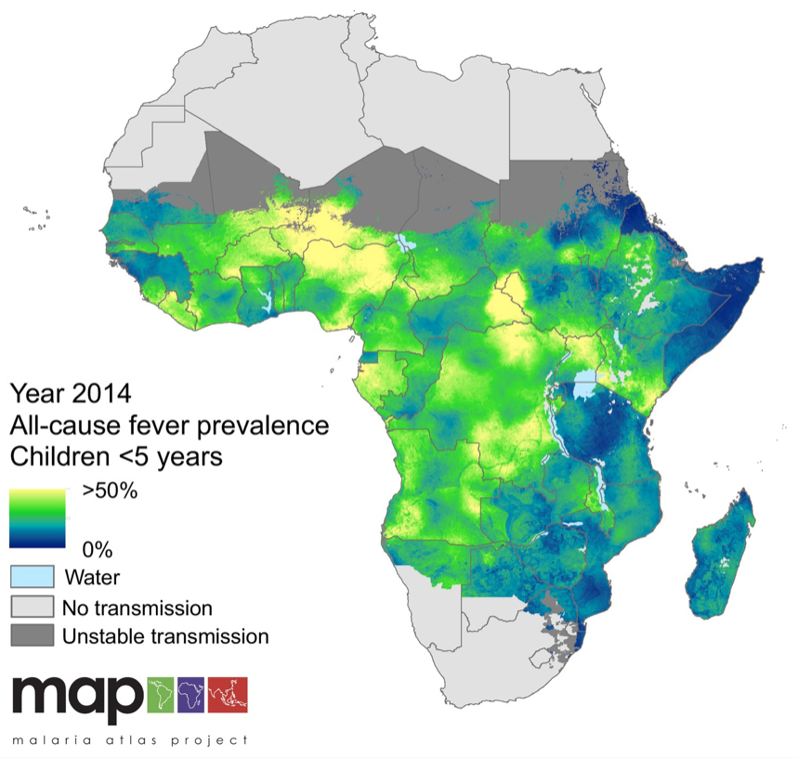
Raster Map [1]:
Spatial resolution matters with raster data!
Problems:
Re-analysis of the same data but at different pixel size can yield wildly different results which is annoying
Unlike vector data, which are series of vector layers can be easily overlaid spatial joining etc., Raster are difficult to achieve this (i.e., align one raster with another) if again, pixel sizes are different.
Incredibly difficult to work with – especially if they are in a high-dimensional format e.g., NetCDF
Depending on the number of pixels and amount of data stored in them – a single raster file can consume at a lot storage space on a PC.
Performing geostatistical modelling and generating raster at a high-resolution can be time consuming and cost-prohibitive for your PC.
Malaria Atlas Project: Modelling prevalence of Malaria
Under < 5 year in Sub-Saharan Africa
41
Notes:
Just to expand a bit more about resolution and how they matter…

Slide 42
Raster Map [2]:
Spatial resolution matters with raster data!
Coarse (or low) resolution
Fine (or high) resolution
25.0km²
1.0km²
5.0km
1.0km
100m
42

Slide 43
Summary
The take home message is:
Vector and Raster data, are the two types of spatial data – the former maps out discrete entities and the latter visualizes entities over a continuous surface.
Features are entities visualized on a map output, the attribute is a quantitative or qualitative description of that feature.
Vectors are points, lines and polygon. A raster is a collection of pixels.
Types of spatial operation
Both types of outputs provide valuable information, but we should be aware of certain limitations for example – vector-based choropleths can result in a severe form of bias known as Ecological Fallacy
Raster outputs on the other hand are dependent pixel size. Two can use the same data and yield different results due to this artefact.
43

Slide 44
Any questions?
44

